Slide 1

Vision
using digital transformation to support pilgrims travelling to hajj & umrah via digital coin
Notes:
سفر الحجاج إلى الحج عبر التحول الرقمي

Slide 2
The Problem
1-The Kingdom is facing tremendous pressure from financial hajj operations & controlling whether from companies or Pilgrims.
2- Pilgrims want to easily deal with money without complicated procedures or fear of stealing their money as well as the procedures of transfers from different currencies
Notes:
تواجه المملكة ضغط هائل من عمليات الحج المالية سواء من الشركات او الحجاج والمعتمرين
يرغب الحجاج بسهولة التعامل المالى دون اجراءات معقدة او خوفا من سرقة مالهم وكذلك اجرءاات عمليات التحويل من العملات المالية المختلفة

Slide 3
Solution: E-Riyal Establishing a unified digital trading currency for Hajj and Umrah operations
E -Financial Solutions
Housing
Travel & Accommodation Arrangements,

Slide 4

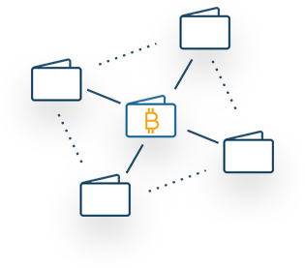


Methodology & services
Customized Block-chain based for Hajj
serve hotels and transportations payments
Notify pilgrims about regulations
Can be used between B2B, then B2C ,C2C and C2B

Slide 5
Advantages
Secured
Easy
Direct
Less Fraud Signature
Minimize fraud and reduce theft for traditional currency
Notes:
امنة وسهلة التداول وتساعد على التقليل من عمليات الاحتيال والحد من سرقة العملة التقليدية

Slide 6

Revenue Model
By 2030,
We will reach 4 million pilgrims to hajj and 11 million for umrah
A stable Cryptocurrency:
Applicable with vision 2030,
More than 2 million pilgrims +
Umrah opening all the year

Slide 7
Competition & Challenges
Competition - KSA Will be face limited Competition because KSA the only country have the resources for hajj and umrah
- Also E-Riyal will be the first digital coin in Saudi Arabia that support hajj & umrah financial operation to all over the world Challenges
we will face challenge to transfer from paper documents & traditional transactions into digital e- financial platform using digital e riyal coin

Slide 8
Team
Mohamed Abd Elmaksoud Rashad
Business Consultant – Project Idea Generator EGYPT
Sarah Alattas KSA
Data Analyst
Islam El-moawen
Software Engineer & Technical team leader EGYPT
Islam El-Deeb
Software Engineer EGYPT

Slide 9
Thanks & Contact
Thanks
e -Riyal Co-Founders
Contact
M.Rashad@jazancci.org.sa
0567698809

